Slide 1

A Tour to Statistically Informed Interactive Maps
Researcher: Carina Zheng
Supervisor: Richard Penny
With Statistics NZ
Notes:
Simple introduction

Slide 2
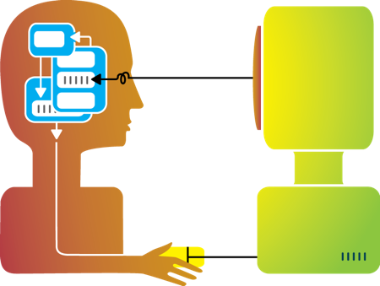
Motivation
Aim: To guide users view problems and results statistically
Questions of interactive plots:
What are the good components?
Why are they good?
What are the bad components?
Why are they bad?
Project outline:
1. Get the feeling - See how others interactive plots look like,
how others users develop the plots,
what the feedbacks from users are like.
2. Experiment - Building our own app.
3. Draw our conclusion
Outline
Motivation
An Example
Background
Concept of the app
Reading Data
Preparation
Parameters
One-mean Table
One-mean Map
Two-mean Table
Scatterplot
Two-mean Map
A Little Taste
More to be done
The End
Notes:
There are many different types of interactive plots online. Therefore, We want to know how to make a user-friendly yet statistically accurate interactive plots which guide and encourage users to view the result in a statistical manner.

Slide 3
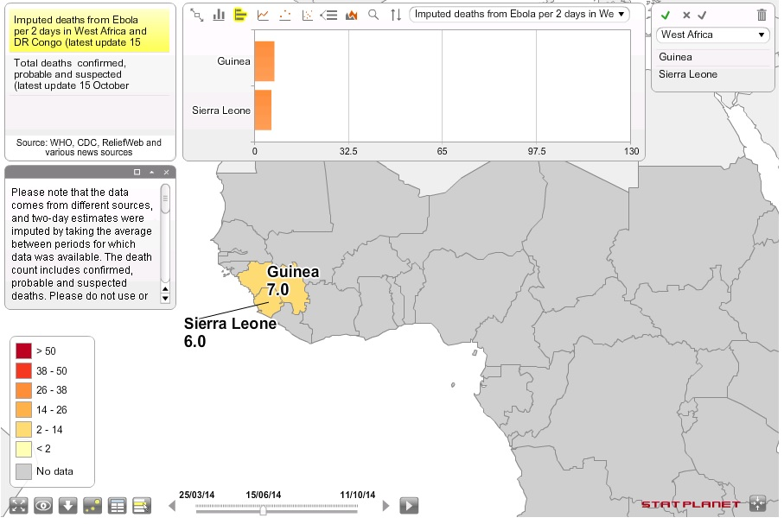
An example
Outline
Motivation
An Example
Background
Concept of the app
Reading Data
Preparation
Parameters
One-mean Table
One-mean Map
Two-mean Table
Scatterplot
Two-mean Map
A Little Taste
More to be done
The End
About this map, I think…
Good ☺
Many functions
Explanations and notes are available
Fancy looking
Bad ☹
Too much on one page
Top panel blocks part of the map
Now let’s start our project!
Map is retrieved from http://www.statsilk.com/maps/interactive-map-ebola-death-rate-west-africa-and-dr-congo-time-animation
Notes:
There are many different types of interactive plots online. Therefore, We want to know how to make a user-friendly yet statistically accurate interactive plots which guide and encourage users to view the result in a statistical manner.

Slide 4

Background
Outline
Motivation
An Example
Background
Concept of the app
Reading Data
Preparation
Parameters
One-mean Table
One-mean Map
Two-mean Table
Scatterplot
Two-mean Map
A Little Taste
More to be done
The End
Source Data: From Statistics New Zealand, titled “Main means of travel to work, for the employed census usually resident population count aged 15 years and over, 2001, 2006, and 2013 Censuses (RC, TA, AU)”
-- data of year 2013 in Territory Authorities (TA) is being used here
Spatial files: ESRI shapefiles named “New Zealand 2013 (NZTM)”, in Census-based files section.
in Territory Authorities (TA)
Operating System: Windows
RStudio, version 0.99.489
R library: 3.2

Slide 5
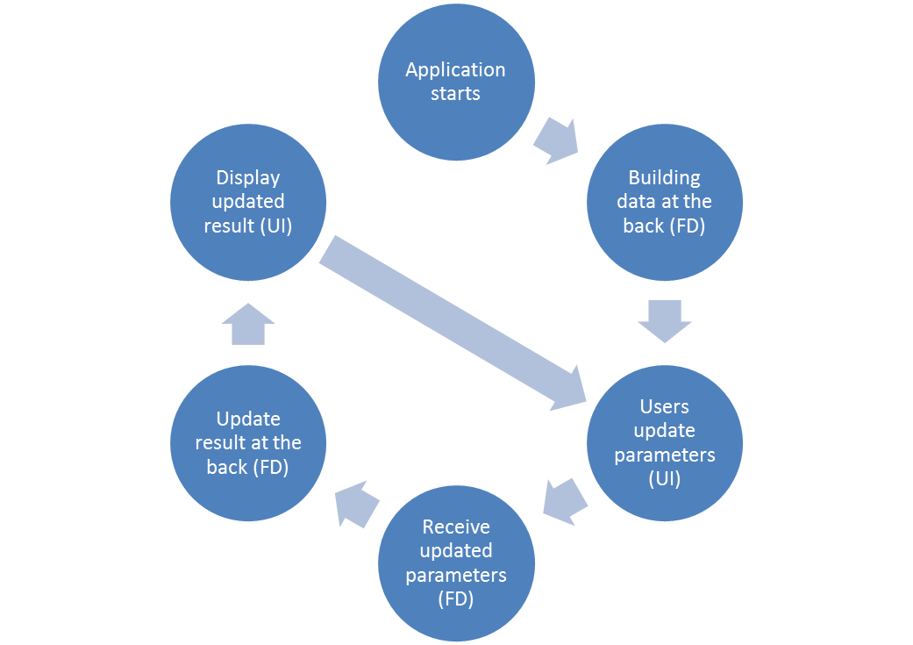
Concept of the app
Outline
Motivation
An Example
Background
Concept of the app
Reading Data
Preparation
Parameters
One-mean Table
One-mean Map
Two-mean Table
Scatterplot
Two-mean Map
A Little Taste
More to be done
The End
Notes:
We are building a bridge between users and the computers here.

Slide 6
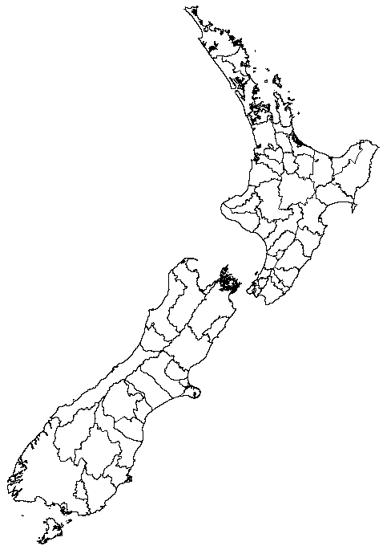
Reading data
Outline
Motivation
An Example
Background
Concept of the app
Reading Data
Preparation
Parameters
One-mean Table
One-mean Map
Two-mean Table
Scatterplot
Two-mean Map
A Little Taste
More to be done
The End
Reading the source data from csv file.
Generating objects from the source data.
Reading the shapefiles into R. (maptools)
Merging the source data to shapefiles object.
Notes:
In csv format for more stable data storing

Slide 7
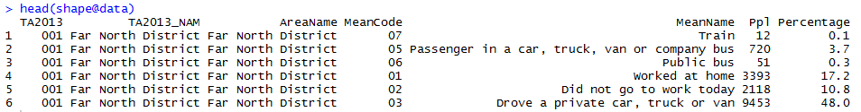
preparation
Outline
Motivation
An Example
Background
Concept of the app
Reading Data
Preparation
Parameters
One-mean Table
One-mean Map
Two-mean Table
Scatterplot
Two-mean Map
A Little Taste
More to be done
The End
Key method:
Calculating Percentages of travel means within territory authorities
Each percentage represents weight of a travel mean being chosen in a territory authority.
The numbers of people used specific travel means / total numbers of people in territory authorities
For example, there are 19,686 people from “Far North District" (a territory authority) involved in the research. 51 people chose "Public bus" (a travel mean) on the survey conducted day. Therefore, the percentage of "Public bus" in " Far North District" is calculated as
51/ 19,686 = 0.3 (1 decimal place)
Notes:
We remain one decimal place in this research because having more decimal places would have the same effect yet it does not have a better reading.

Slide 8
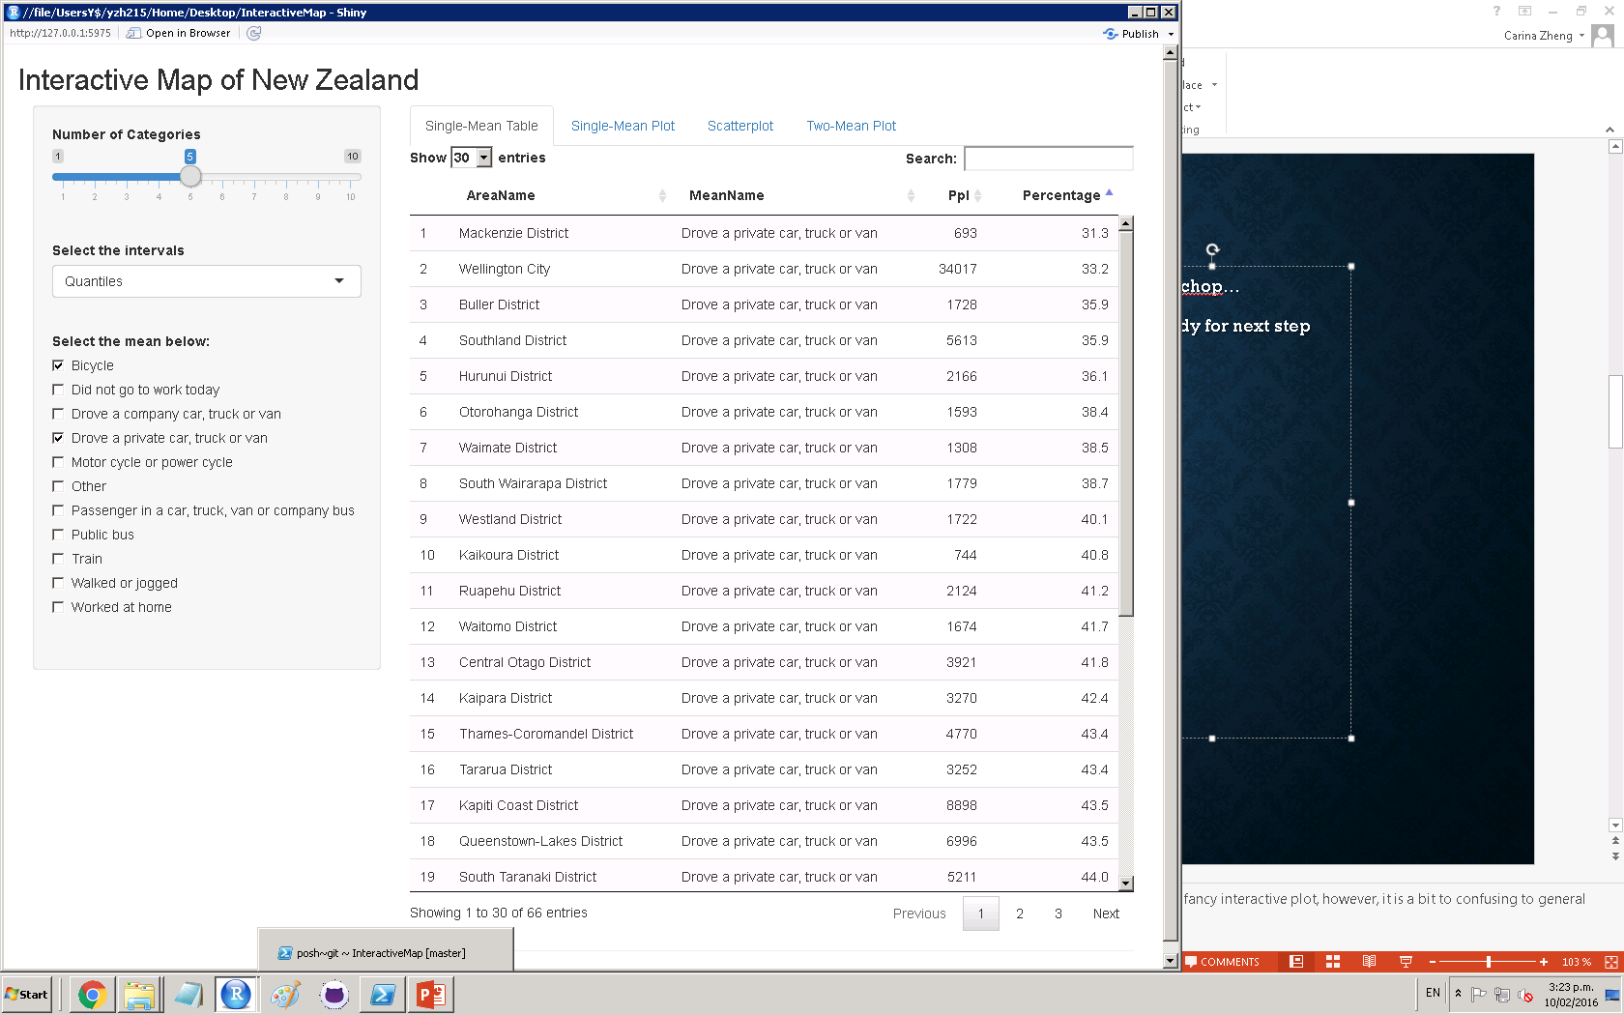
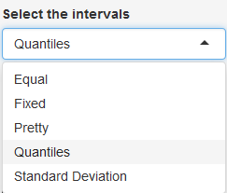
Parameters
Select the number of categories which is used for:
Separating the full data.
Assigning color to each value.
Outline
Motivation
An Example
Background
Concept of the app
Reading Data
Preparation
Parameters
One-mean Table
One-mean Map
Two-mean Table
Scatterplot
Two-mean Map
A Little Taste
More to be done
The End
Select the interval which is used for:
Separating the full data.
Assigning color to each value.
Select one travel mean to view, OR
Select two travel means to compare.

Slide 9
One-mean table
Outline
Motivation
An Example
Background
Concept of the app
Reading Data
Preparation
Parameters
One-mean Table
One-mean Map
Two-mean Table
Scatterplot
Two-mean Map
A Little Taste
More to be done
The End
Selecting the subset of the source dataset. Such subset is using the same travel mean as the user last selected mean (in “mean selection” on the left hand panel).
Mainly using Shiny package for User Interface building.
Table is updated and rendered once the mean is changed.
Notes:
We have browsed many different types of interactive websites, and we are using this specific one from StatSilk as an example. There’s no doubt that this is a fancy interactive plot, however, it is a bit to confusing to general audience in my opinion because…

Slide 10
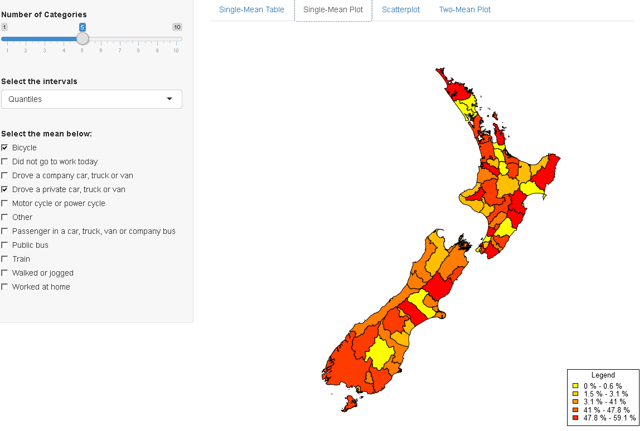
One-mean map
Key functions:
colorRampPalette – generating required series of colors. Supplying n, it returns n progressive colors.
classIntervals – separate data into n sets by selected style and their values.
findColours – match each value in dataset to a color
Customized legend –
“%” after numbers
Beginnings of intervals are added
“-” are added
Outline
Motivation
An Example
Background
Concept of the app
Reading Data
Preparation
Parameters
One-mean Table
One-mean Map
Two-mean Table
Scatterplot
Two-mean Map
A Little Taste
More to be done
The End

Slide 11
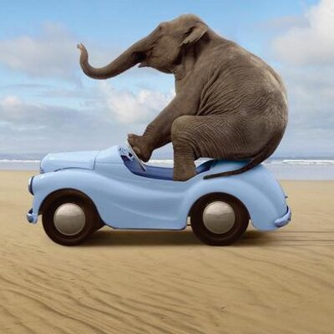
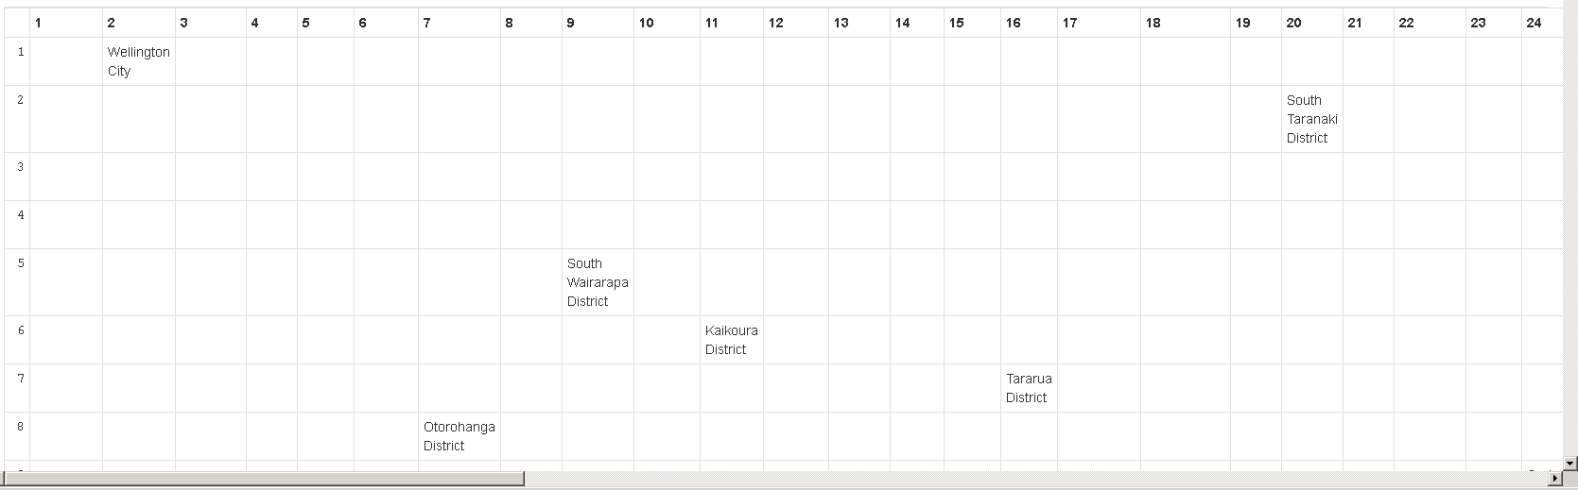
Two-mean table
Outline
Motivation
An Example
Background
Concept of the app
Reading Data
Preparation
Parameters
One-mean Table
One-mean Map
Two-mean Table
Scatterplot
Two-mean Map
A Little Taste
More to be done
The End
Eh… perhaps too much to squeeze in?

Slide 12
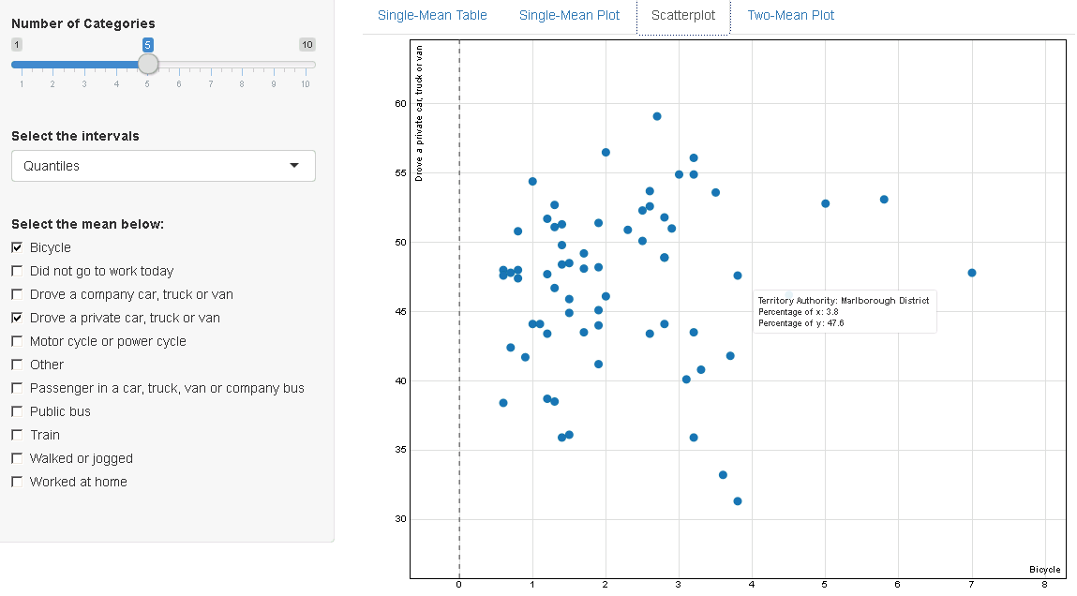
Scatterplot
Rank the territory authorities by percentages in separate travel means. The ranks are the x and y positions of the data points.
Supply the dataset to key function scatterD3. It draws the interactive scatterplot.
Outline
Motivation
An Example
Background
Concept of the app
Reading Data
Preparation
Parameters
One-mean Table
One-mean Map
Two-mean Table
Scatterplot
Two-mean Map
A Little Taste
More to be done
The End

Slide 13
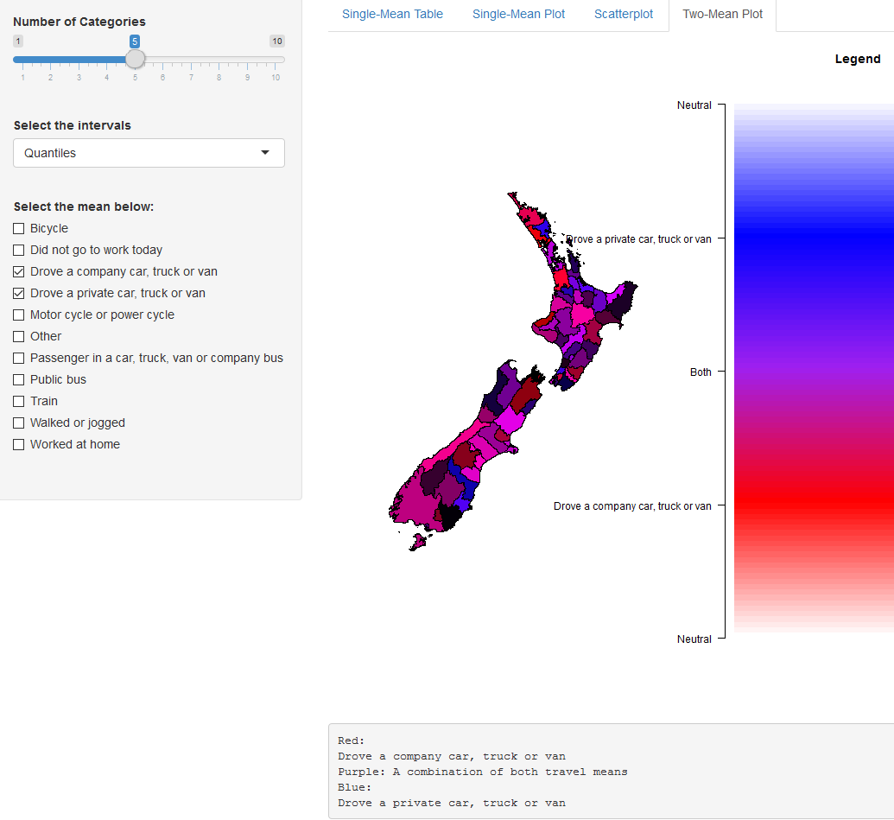
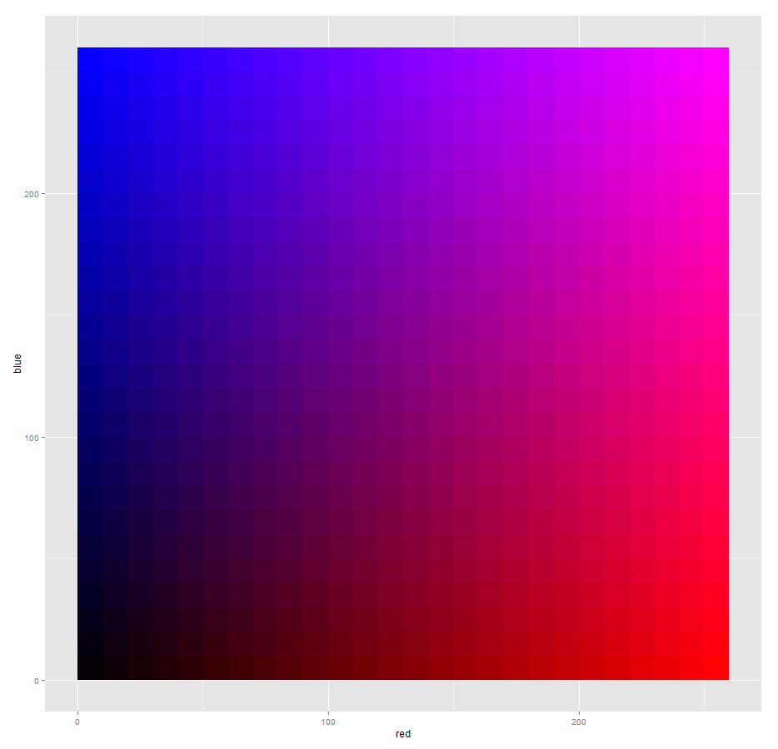
Two-mean map
Calculate the colors by their percentages in both means.
Progressive colors changing from blue (first selected travel mean) to red (second selected travel mean).
Legend is customized to distinguish the colors.
Outline
Motivation
An Example
Background
Concept of the app
Reading Data
Preparation
Parameters
One-mean Table
One-mean Map
Two-mean Table
Scatterplot
Two-mean Map
A Little Taste
More to be done
The End
Why we don’t use the image as legend?

Slide 14
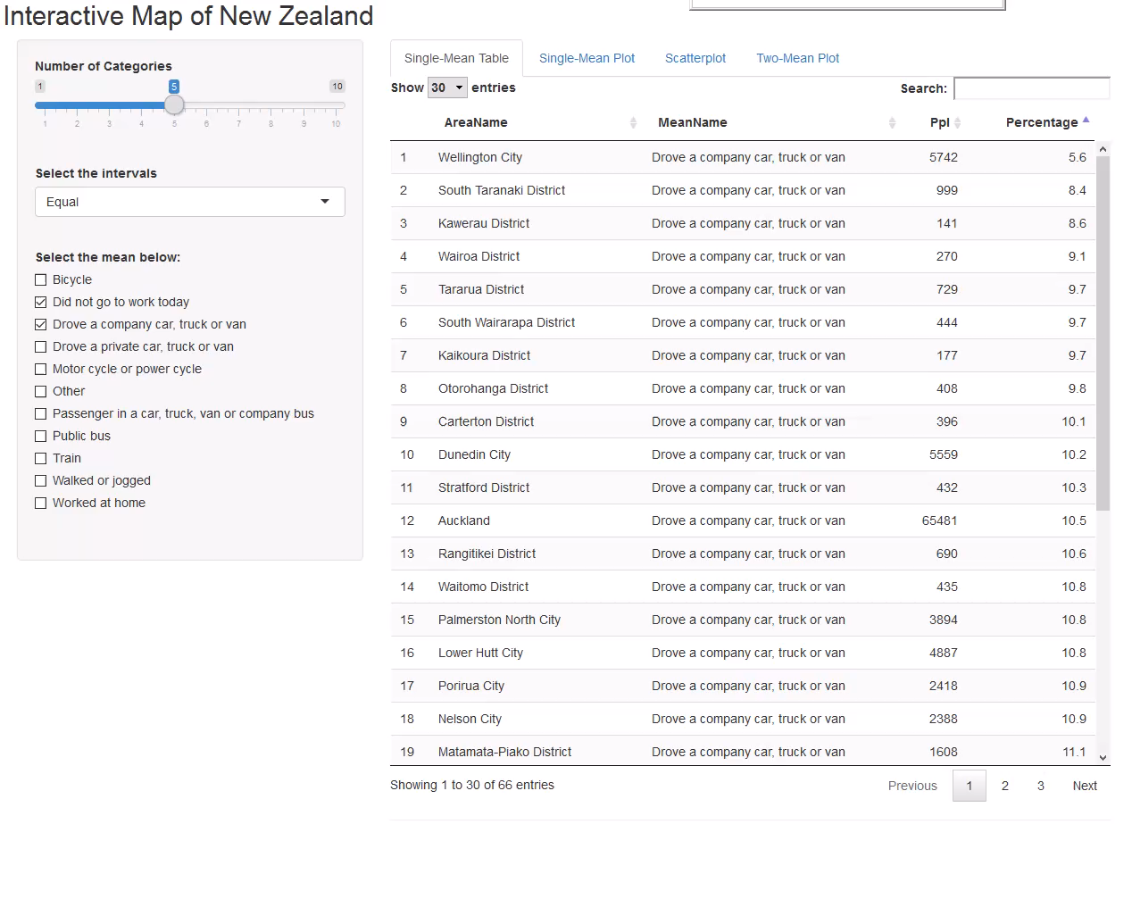
A little taste
Outline
Motivation
An Example
Background
Concept of the app
Reading Data
Preparation
Parameters
One-mean Table
One-mean Map
Two-mean Table
Scatterplot
Two-mean Map
A Little Taste
More to be done
The End

Slide 15

More to be done
Outline
Motivation
An Example
Background
Concept of the app
Reading Data
Preparation
Parameters
One-mean Table
One-mean Map
Two-mean Table
Scatterplot
Two-mean Map
A Little Taste
More to be done
The End
Better style
Correlation analysis
Interactive linear regression
More statistical analysis
……

Slide 16
Hope you enjoyed it and thank you for your time!
Special thanks to Richard Penny (Supervisor)
UC staff
Statistics NZ
for the professional advices, help and the opportunity!
Outline
Motivation
An Example
Background
Concept of the app
Reading Data
Preparation
Parameters
One-mean Table
One-mean Map
Two-mean Table
Scatterplot
Two-mean Map
A Little Taste
More to be done
The End

